Slide 1
How Things Work at the Ohio Statehouse
Break the Supermajority Edition!!
Presented by Rachel Coyle

Slide 2
DISCLAIMER: Tonight’s version of this presentation is progressive and political! (Traditional “How Things Work” presentation is non-partisan and issue-focused)
GOAL: Break the longtime Republican Supermajority in Ohio’s Statehouse by electing Democrats in 2020.

Slide 3
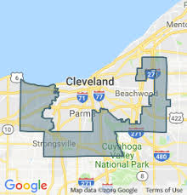
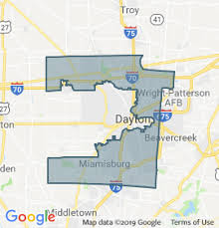
Bullet points so Rachel doesn’t forget her intro:
DON’T WORRY about memorizing this info or the links. We’ll email everything to you!
DON’T WORRY if you haven’t paid attention to Statehouse politics before. This is the perfect year to start.
In many ways, Statehouses are THE SINGLE most important branch of government.
Gerrymandering: State legislators pick your Congress members.

Slide 4
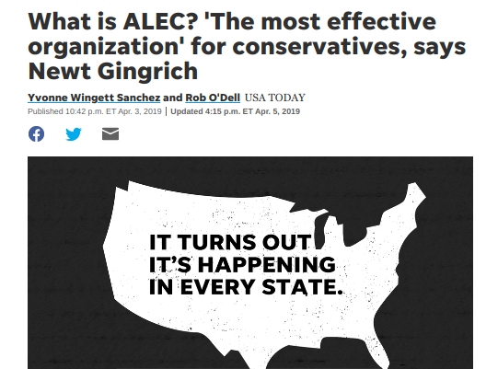
Who needs Congress when you can pass the same bill through 40+ Statehouses at once?

Slide 5
REMEMBER:
You have SO MUCH POWER at the Statehouse level.
Why? Because hardly anyone contacts their state legislators.
It DOES NOT take very many people to make noise at the Statehouse.
Use this power. If you don’t, someone else will.

Slide 7
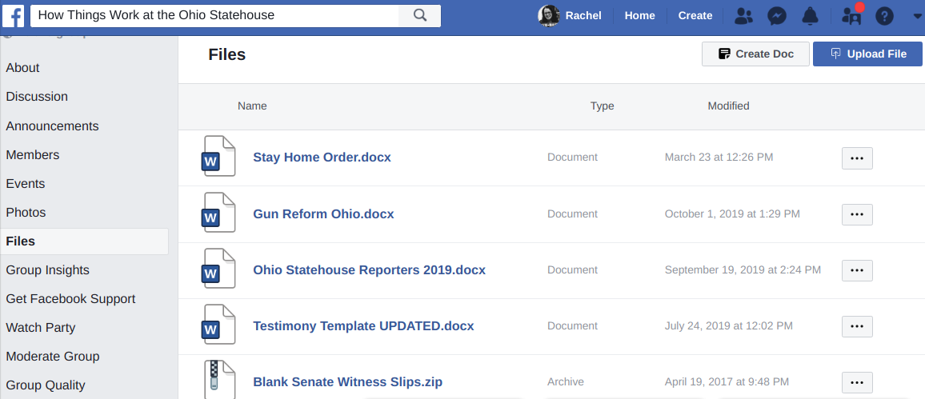

Slide 8
TAKE OUT YOUR PHONE!
Twitter: @HowThingsWorkOH
Twitter List: “Reporters to Follow”
Facebook: How Things Work at the Statehouse
Want to email Rachel?
HowThingsWorkOH@gmail.com

Slide 9
WHAT WE’LL COVER TODAY:
Statehouse Basics
How a bill becomes a law in Ohio (& what you can do about it)
Resources!!
Some of the most flippable Ohio Statehouse seats!!
Q&A

Slide 10
STATEHOUSE BASICS – TERMS
TERM TO KNOW: “General Assembly” or “G.A.”
The Statehouse operates in 2-year terms called G.A.s
Any bill that doesn’t pass by the end of the G.A. dies and has to be reintroduced next G.A.
TERM TO KNOW: “Session”
The time of year when legislators are working, AND the times they’re actually in the chamber voting on bills.
TERM TO KNOW: “Lame Duck”
The majority party tends to save the most controversial bills for the “Lame Duck” session.
Next Lame Duck Session? Mid November – Mid December 2020.
HB 378

Slide 11
STATEHOUSE BASICS – THE NUMBERS
TERM TO KNOW: ”Supermajority”
Ohio Senate has 33 senators.
24 Republicans – 9 Democrats.
Ohio House has 99 members.
61 Republicans – 38 Democrats.
Veto Power

Slide 12
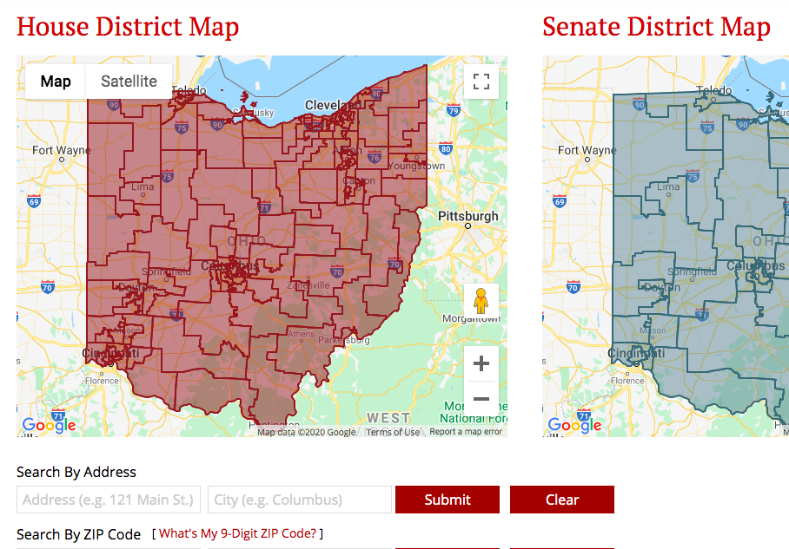
WANT TO FIND YOUR REP/SENATOR?
Legislature.Ohio.Gov → Legislators → District Maps
Type your address

Slide 13
HOW A BILL BECOMES A LAW IN OHIO (AND WHAT YOU CAN DO ABOUT IT)
Step 1: A bill is introduced in the House or Senate.
Sometimes it’s introduced in the House AND Senate.
Bills are numbered in order of introduction.
So HB 1 was the first bill in the House this G.A.
Bills keep their same name and number throughout the entire two-year term.
So HB 1 will STAY HB 1 when it goes over to the Senate.

Slide 14
HOW A BILL BECOMES A LAW IN OHIO (AND WHAT YOU CAN DO ABOUT IT)
Step 2: Once a bill is introduced, it’s assigned to a committee.
ACTION ITEM: CONTACT committee chairs.
Ask to be placed on their
“committee notice list.”

Slide 15
Legislature.Ohio.gov

Slide 17
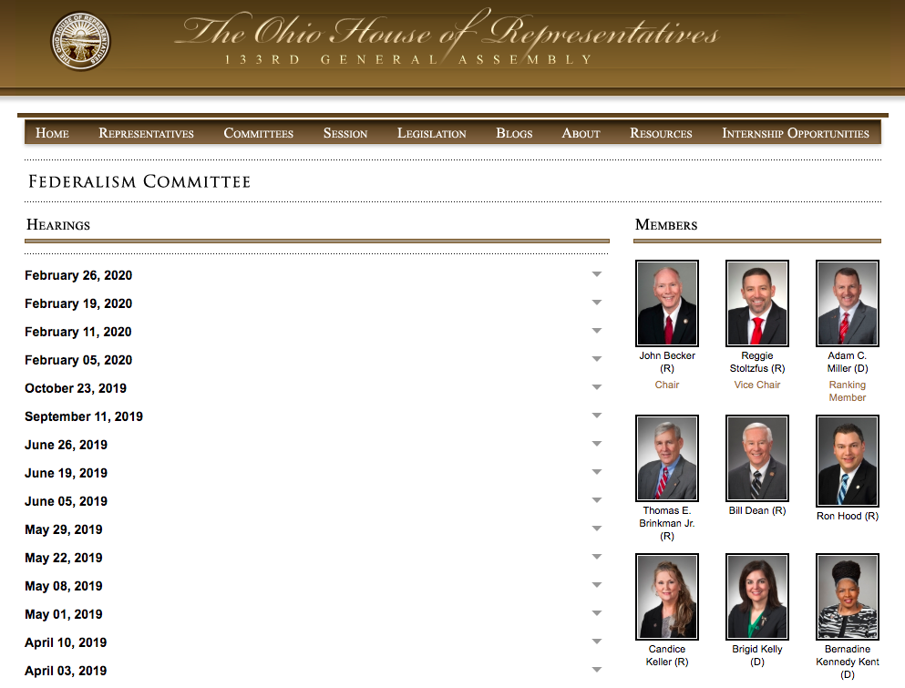

Slide 18
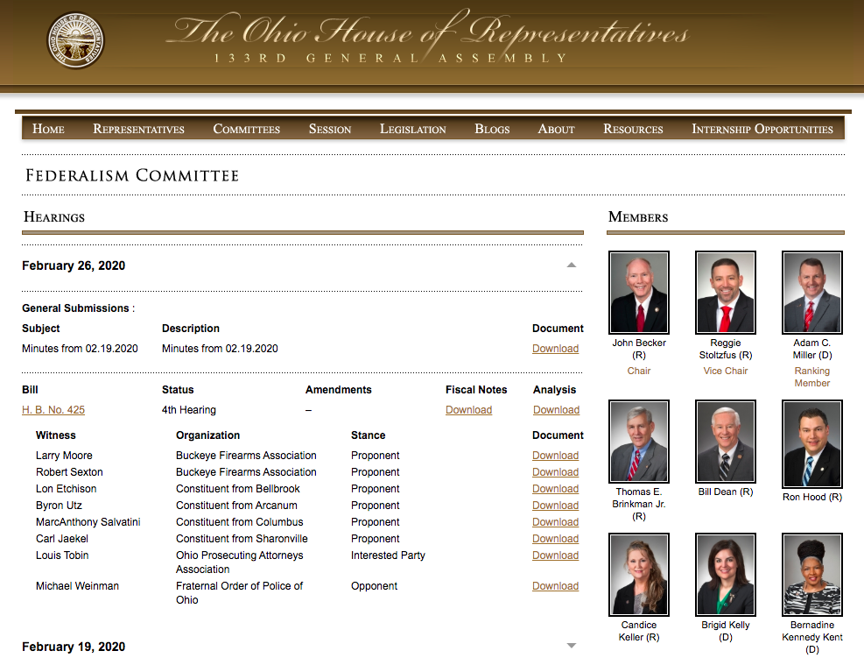

Slide 19
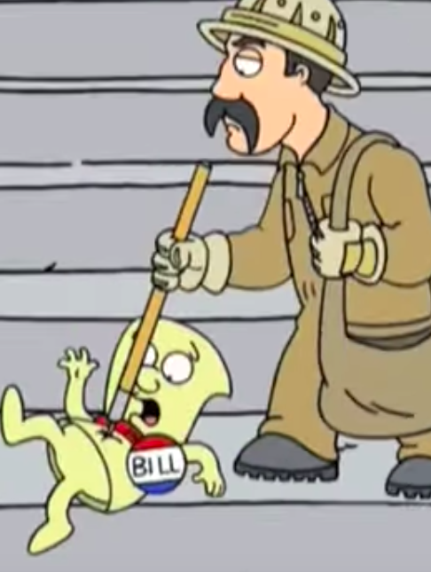
HOW A BILL BECOMES A LAW IN OHIO (AND WHAT YOU CAN DO ABOUT IT)
Step 3: Bills (usually….) Get Hearings.
Committee hearings (normal process):
1st hearing – sponsor testimony
2nd hearing – proponent testimony (supporter)
3rd hearing – opponent/interested party testimony
But the number of hearings can change!
ACTION ITEM: Demand hearings for good bills!
ACTION ITEM: Slow down bad bills!

Slide 20
YES. I SAID CALL.
It’s not like calling Congress. They aren’t asking for zip codes or taking a tally.
Remember: You’re not talking to the legislator. You’re talking to their overworked, underpaid aide. Be nice!
Each state rep only has 1 aide.
Each senator only has 2 aides.
Build a relationship.
And they WILL get your messages. There’s only 1 phone line per legislator.
So you’re calling the same number that the legislators call….

Slide 21
TESTIFYING IN COMMITTEE
Come testify for/against bills at the Statehouse!
GOAL: Testify in person.
Please TRY TO present your testimony in person whenever possible. BUT….
Can’t testify in person? You can also submit written-only testimony.

Slide 22
HOW TO SUBMIT TESTIMONY (IN-PERSON OR WRITTEN-ONLY!):
STEP 1: Write your testimony.
STEP 2: Email your (written or in-person) testimony to the Committee Chair. 24 hours in advance.
STEP 3: The committee chair will send you a “Witness Slip” form to fill out.
If you’re submitting written-only testimony, that’s it. You’re done!
If you’re testifying in person, all that’s left is to show up!

Slide 23
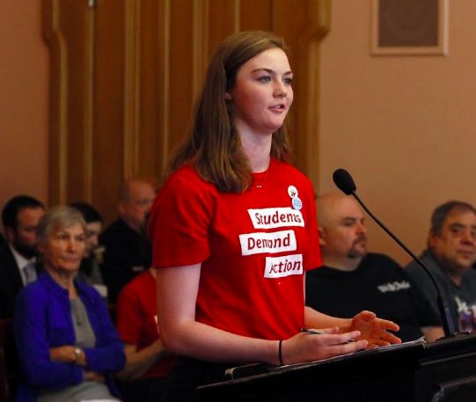

Slide 24
WHAT MAKES GOOD TESTIMONY
Short and sweet!!
If there’s a lot of testimony, you’ll likely be limited to 2-3 minutes. Make them count.
Consider your audience
Think of your most conservative relative. That’s your audience.

Slide 25
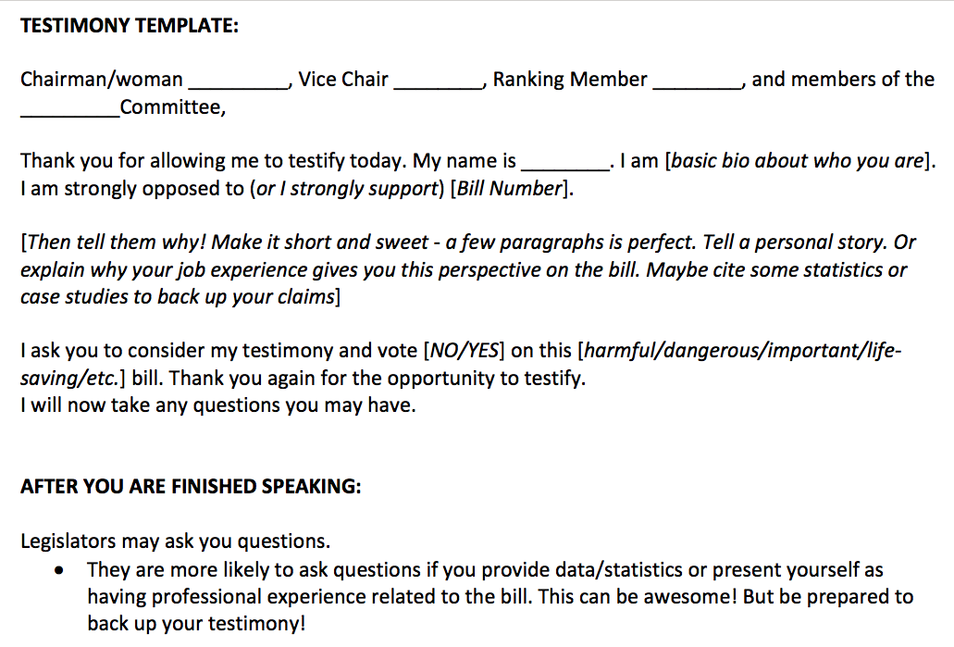

Slide 26
This is stressful. You deserve a few seconds to breathe. Here’s a kitten.
Now, on to the next part of the presentation!

Slide 27
More Ohioans have started to care about the Statehouse recently! Yay! BUT….
We’ve started seeing new rules recently too:
Invite-only testimony
Limited number of testimonies accepted.
It will take public pressure to stop these new rules from becoming the norm.
Post all over social media!
Make sure the press knows!
Protest in the halls of the Statehouse.
Eventually, committee chairs will realize it’s much easier to just let everyone testify.

Slide 28
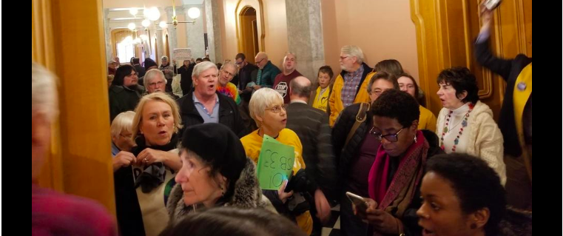

Slide 29
LIVE BROADCASTS OF COMMITTEE HEARINGS
You can watch all House and Senate Sessions AND all committee hearings live on OhioChannel.org – it’s free!
The videos are also archived on the site!
This is a massive win for Statehouse Democrats.

Slide 31
SO A BILL PASSES OUT OF COMMITTEE….
Once a bill passes out of committee, it next needs to receive a full floor vote.
Some bills get through committee but never get to the floor.

Slide 32
SO A BILL GETS A FLOOR VOTE….
If it passes one chamber (the House or the Senate), it then has to go through the full process in the other chamber.

Slide 33
This is stressful. You deserve a few seconds to breathe. Here’s a puppy.
Now, on to the next part of the presentation!

Slide 34
RESOURCES - OHIOHOUSE.GOV AND OHIOSENATE.GOV

Slide 35
RESOURCES - OHIOHOUSE.GOV AND OHIOSENATE.GOV

Slide 36
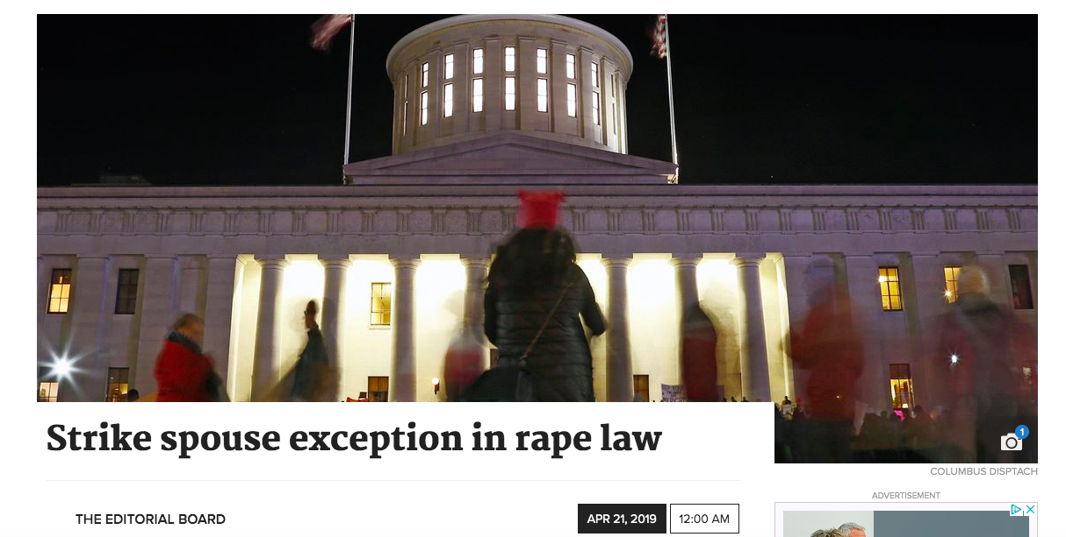
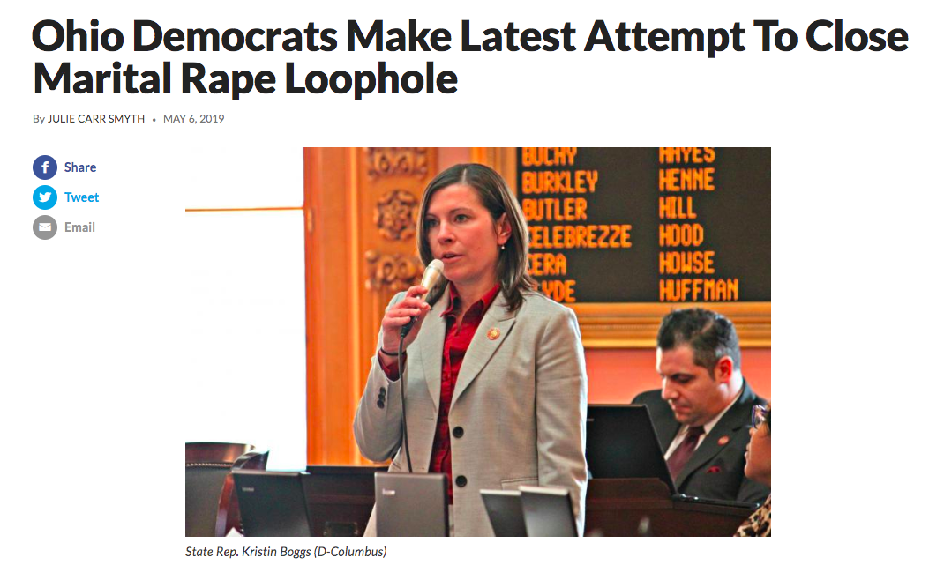

Slide 37
OhioHouse.gov

Slide 38
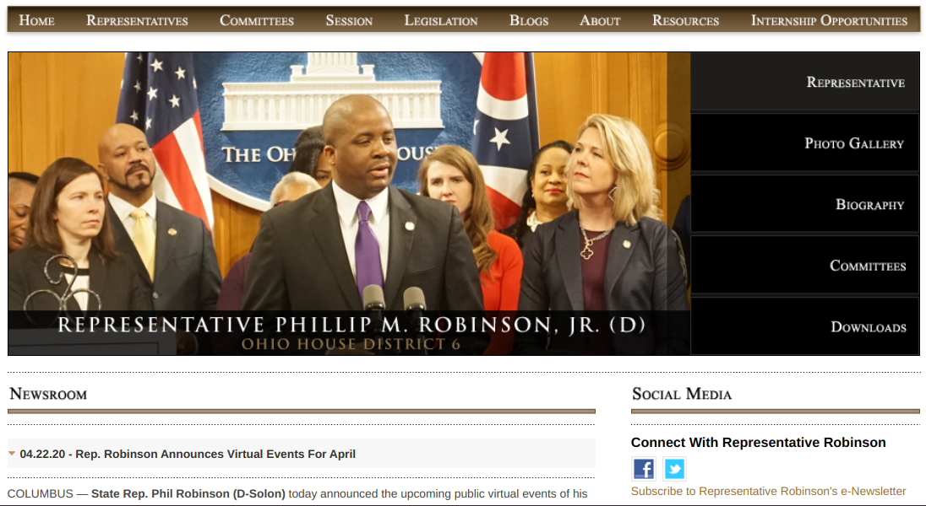
RESOURCES - OHIOHOUSE.GOV AND OHIOSENATE.GOV

Slide 39
RESOURCES – ADVOCACY ORGANIZATIONS

Slide 40
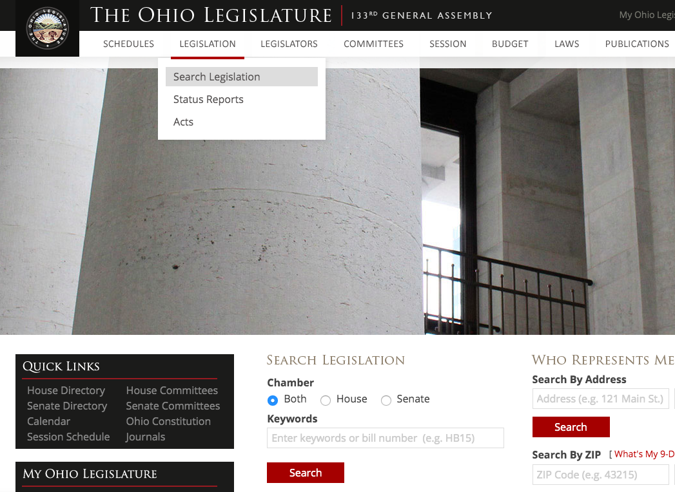
HOW TO FIND STATEHOUSE BILLS
Legislature.Ohio.gov

Slide 41
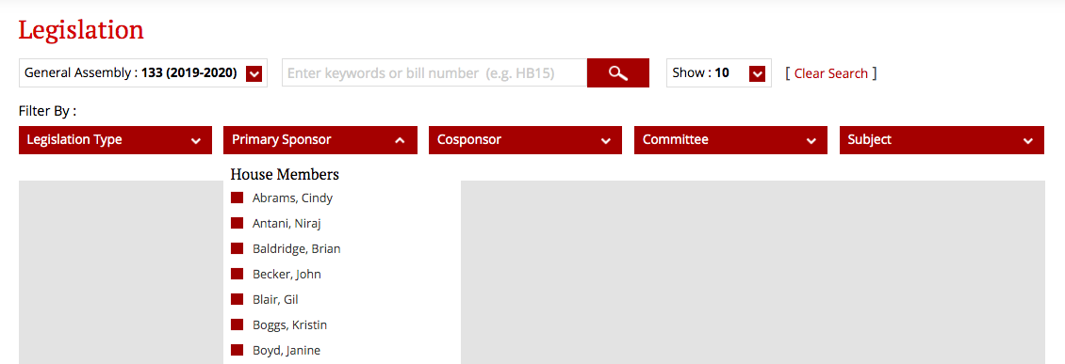
HOW TO FIND STATEHOUSE BILLS
Legislature.Ohio.gov → Legislation → Search Legislation

Slide 42
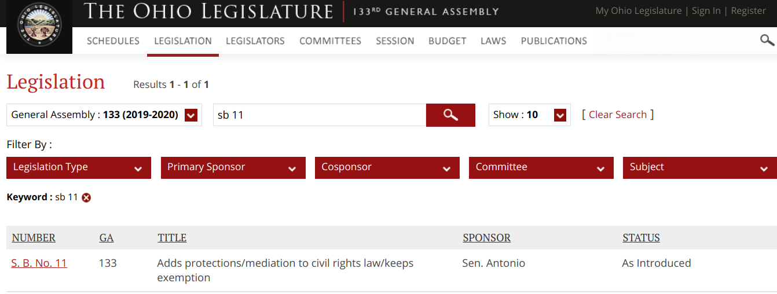

Slide 43
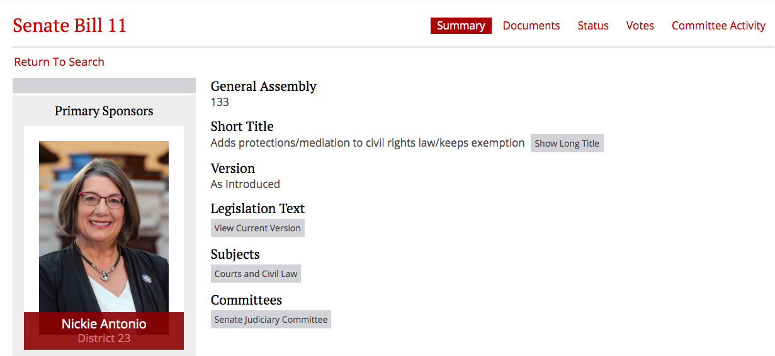
BILL PAGES LOOK LIKE….

Slide 44
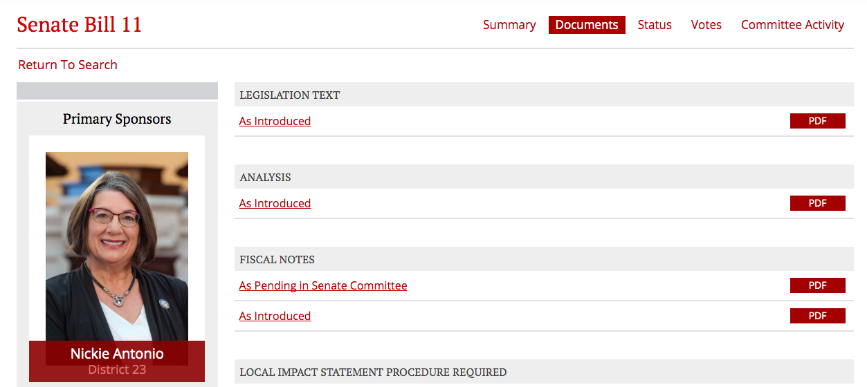
The Documents Tab is so important!

Slide 45
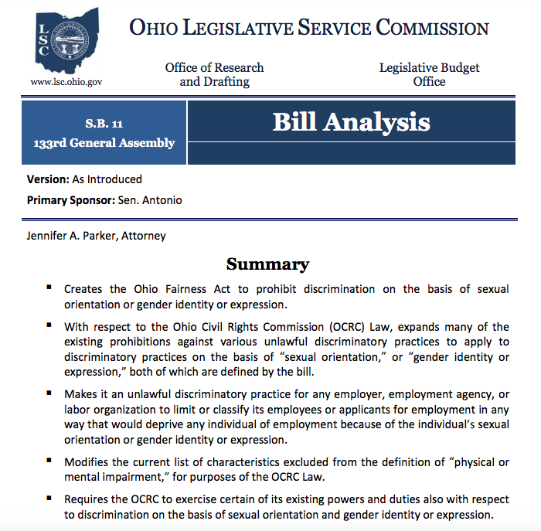

Slide 46
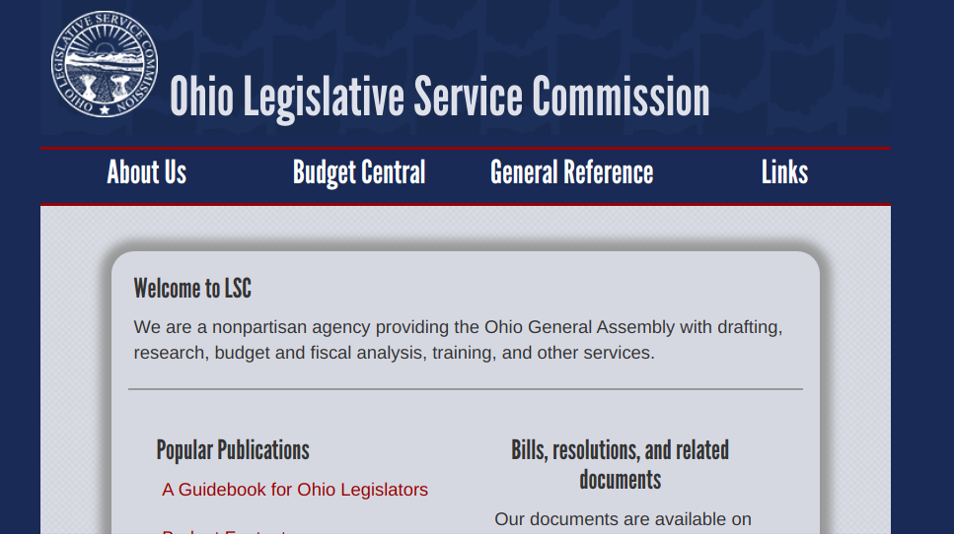
www.LSC.Ohio.gov -- You need the www. Don’t ask me why.

Slide 47
2020 Goal -- Break the Statehouse Supermajority
❗️1) Ohio House Dems only need TWO seats to stop veto overrides & block bad constitutional amendments.
❗️2) Whoever is elected in 2020 will help redraw Ohio's legislative and congressional district lines….
❗️3) Senate Dems only need THREE seats to stop bad bills from being passed by emergency clause.

Slide 48
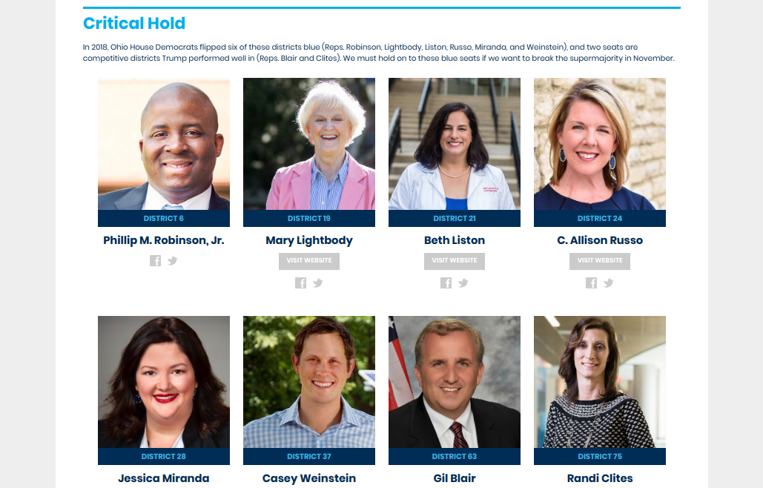
How to break the Statehouse supermajority
HOUSE - Need 2 seats to break the ⅗ supermajority
OHHouseDems.com

Slide 49
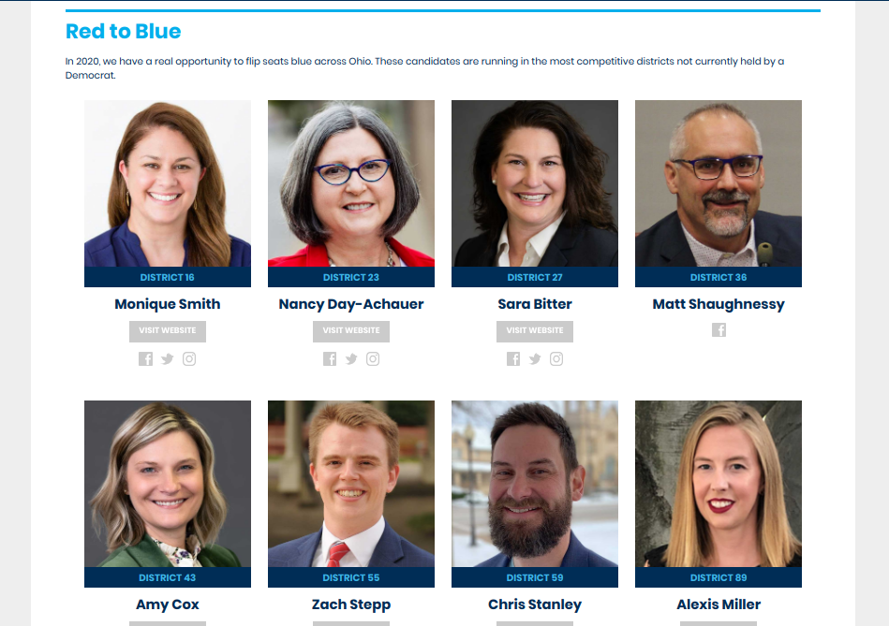
How to break the Statehouse supermajority
HOUSE - Need 2 seats to break the ⅗ supermajority
OHHouseDems.com
Monique Smith -- HD 16 vs Rep Greenspan (Bay Village, Fairview Park, North Olmsted, Rocky River, Westlake.)
Nancy Day-Auchauer -- HD 23 vs Rep Lanese ( Grove City, Jackson Township, Urbancrest, portions of Hilliard, Norwich Township, Prairie Township, Franklin Township, parts of Columbus.)
Sara Bitter -- HD 27 vs Rep Brinkman (Eastern Hamilton County, Indian Hill, Loveland, Milford)
Matt Shaughnessy -- HD 36 vs Bob Young in SE Summit County
Amy Cox -- HD 43 vs Rodney Creech (Preble County, western/central Montgomery County)
Zach Stepp -- HD 55 vs Rep Manning (NE Lorain County, Elyria)
Chris Stanley -- HD 59 vs TBD (Western, central, southern Mahoning County)
Alexis Miller -- HD 89 vs Rep Swearingen (Erie and Ottawa counties)

Slide 50
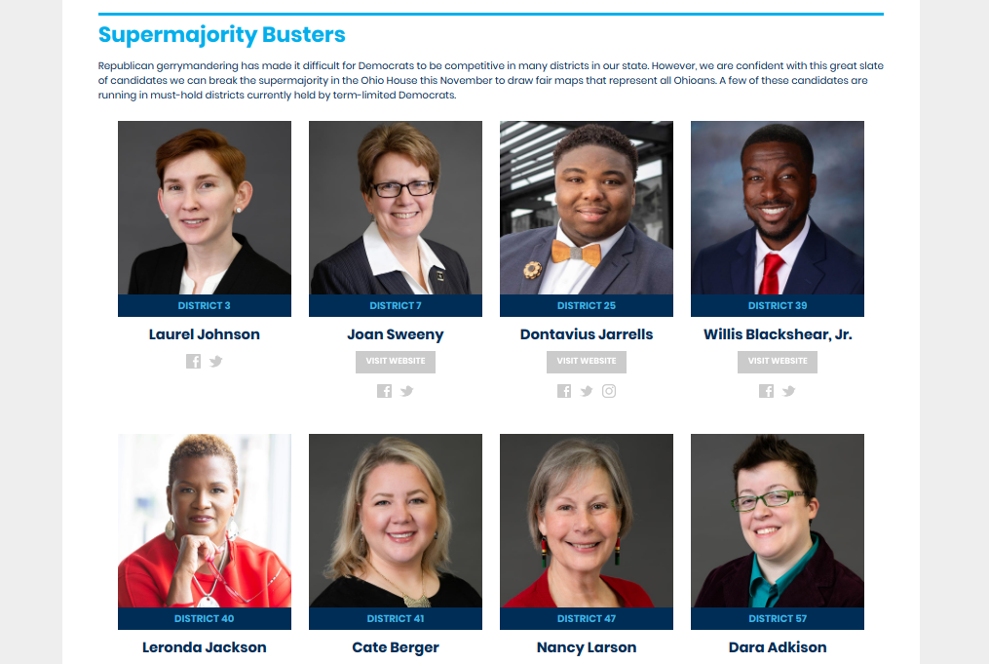
How to break the Statehouse supermajority
HOUSE - Need 2 seats to break the ⅗ supermajority
OHHouseDems.com

Slide 51
How to break the Statehouse supermajority
SENATE
Need 3 seats to break the 2/3 supermajority
Need 5 seats to break the ⅗ supermajority
OhioSenateDemocrats.com

Slide 52
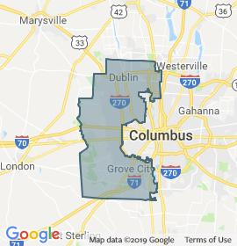
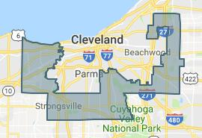
How to break the Statehouse supermajority
SENATE
Need 3 seats to break the 2/3 supermajority
Need 5 seats to break the ⅗ supermajority
OhioSenateDemocrats.com

Slide 53
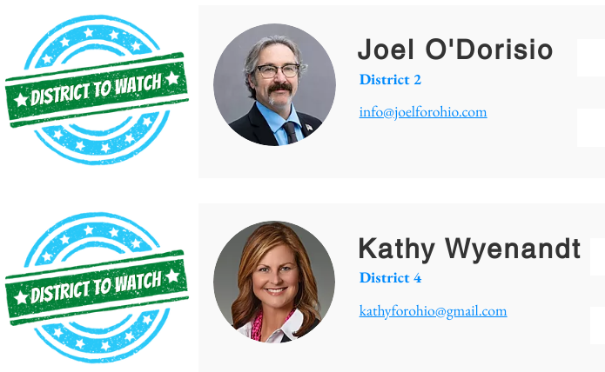
How to break the Statehouse supermajority
SENATE
Need 3 seats to break the 2/3 supermajority
Need 5 seats to break the ⅗ supermajority
OhioSenateDemocrats.com

Slide 54
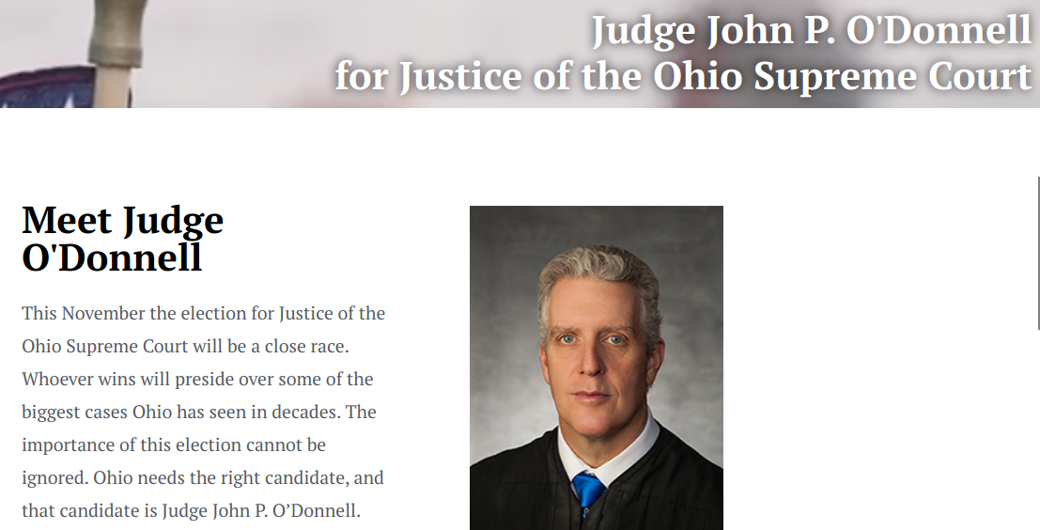
THE OHIO SUPREME COURT.
is. CRITICAL.

Slide 55
THINGS TO REMEMBER:
Anything you do at the Statehouse level is more than was happening before!
YOU HAVE SO MUCH POWER at the Statehouse level.

Slide 56
QUESTIONS?

