Slide 1
How Things Work at the Ohio Statehouse
Presented by Rachel Coyle

Slide 2
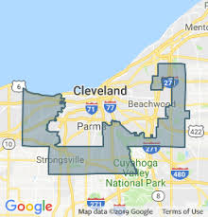
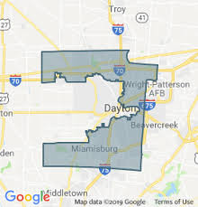
Bullet points so Rachel doesn’t forget her intro:
DON’T WORRY about memorizing this info or the links. We’ll email everything to you!
DON’T WORRY if you haven’t paid attention to Statehouse politics before. This is the perfect year to start.
In many ways, Statehouses are THE SINGLE most important branch of government.
Gerrymandering: State legislators pick your Congress members.

Slide 3
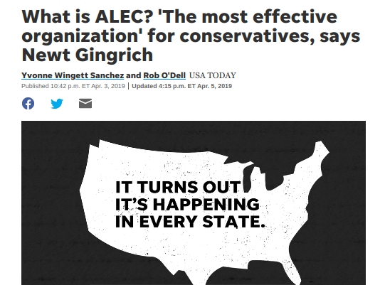
Who needs Congress when you can pass the same bill through 40+ Statehouses at once?

Slide 4
REMEMBER:
You have SO MUCH POWER at the Statehouse level.
Why? Because hardly anyone contacts their state legislators.
It DOES NOT take very many people to make noise at the Statehouse.
Use this power. If you don’t, someone else will.

Slide 5
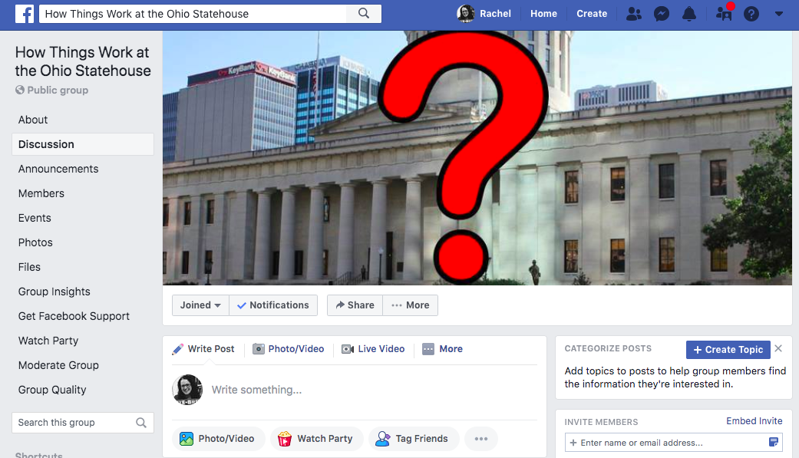

Slide 6
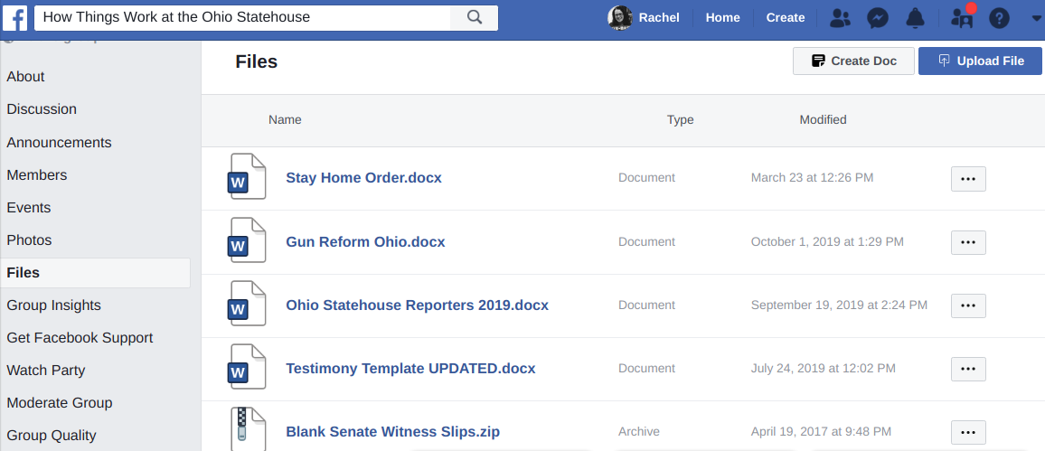

Slide 7
TAKE OUT YOUR PHONE!
Twitter: @HowThingsWorkOH
Twitter List: “Reporters to Follow”
Facebook: How Things Work at the Statehouse
Want to email Rachel? HowThingsWorkOH@gmail.com

Slide 8
WHAT WE’LL COVER TODAY:
Statehouse Basics
How a bill becomes a law in Ohio
(and what you can do about it)
Resources!!
Q&A

Slide 9
STATEHOUSE BASICS – TERMS
TERM TO KNOW: “General Assembly” or “G.A.”
The Statehouse operates in 2-year terms called G.A.s
Any bill that doesn’t pass by the end of the G.A. dies and has to be reintroduced next G.A.
TERM TO KNOW: “Session”
The time of year when legislators are working, AND the times they’re actually in the chamber voting on bills.
TERM TO KNOW: “Lame Duck”
The majority party tends to save the most controversial bills for the “Lame Duck” session.
Next Lame Duck Session? Mid November – Mid December 2020.
HB 378

Slide 10
STATEHOUSE BASICS – THE NUMBERS
TERM TO KNOW: ”Supermajority”
Ohio Senate has 33 senators.
24 Republicans – 9 Democrats.
Ohio House has 99 members.
61 Republicans – 38 Democrats.
Veto Power

Slide 11
LARRY VS LARRY
VS.
Senate President Obhof House Speaker Householder

Slide 12
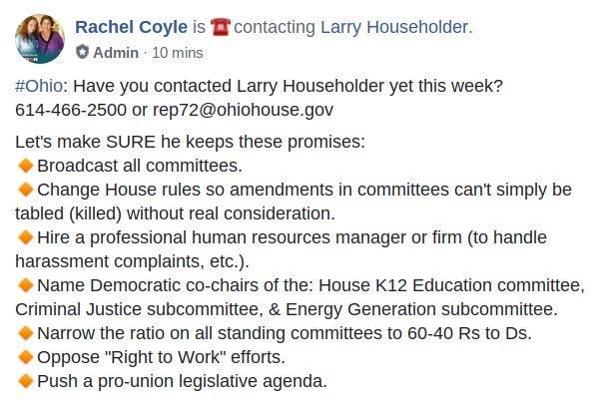
LARRY HOUSEHOLDER’S PROMISES

Slide 13
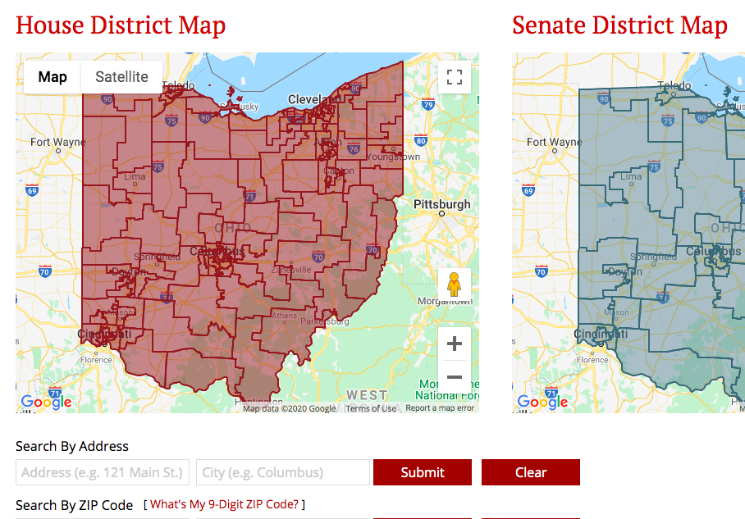
WANT TO FIND YOUR REP/SENATOR?
Legislature.Ohio.Gov → Legislators → District Maps
Type your address

Slide 14
HOW A BILL BECOMES A LAW IN OHIO (AND WHAT YOU CAN DO ABOUT IT)
Step 1: A bill is introduced.
It can be introduced in either the House or Senate.
Sometimes it’s introduced in the House AND Senate.
Bills are numbered in order of introduction.
So HB 1 was the first bill in the House this G.A.
Bills keep their same name and number throughout the entire two-year term.
So HB 1 will STAY HB 1 when it goes over to the Senate.

Slide 15
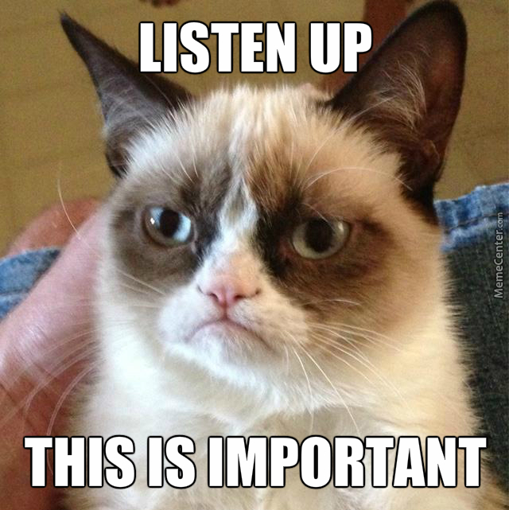
HOW A BILL BECOMES A LAW IN OHIO (AND WHAT YOU CAN DO ABOUT IT)
Step 2: Once a bill is introduced, it’s assigned to a committee.
ACTION ITEM: CONTACT committee chairs. Ask to be placed on their “committee notice list.”

Slide 18
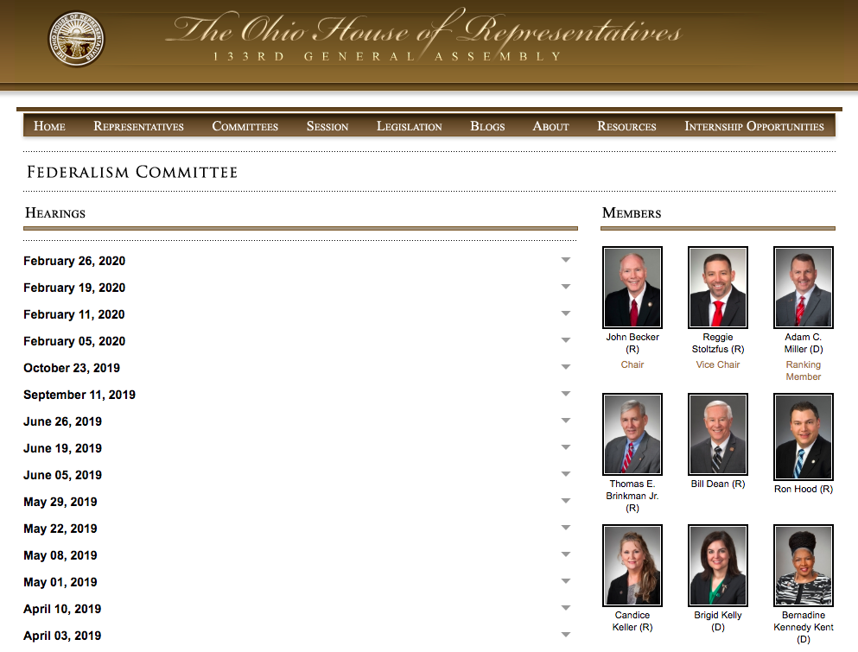

Slide 19
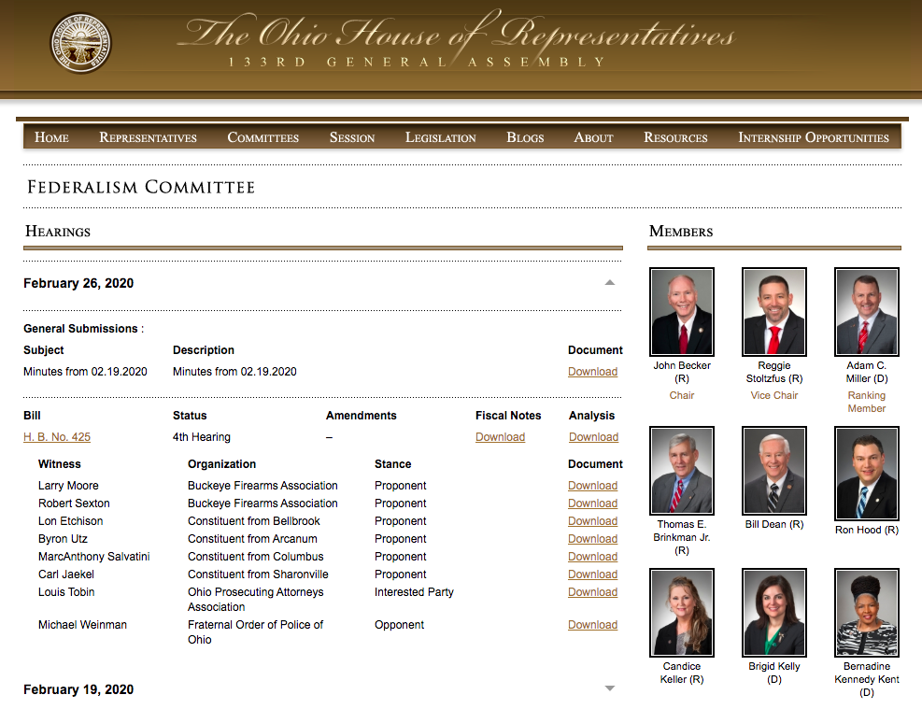

Slide 20
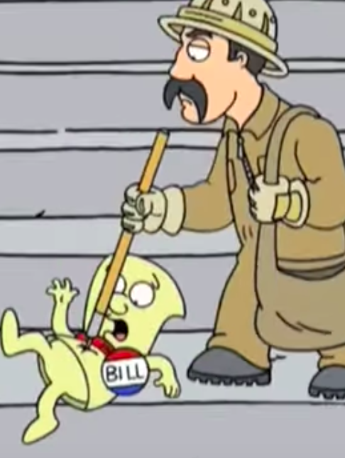
HOW A BILL BECOMES A LAW IN OHIO (AND WHAT YOU CAN DO ABOUT IT)
Step 3: Bills (usually….) Get Hearings.
Committee hearings (normal process):
1st hearing – sponsor testimony
2nd hearing – proponent testimony (supporter)
3rd hearing – opponent/interested party testimony
But the number of hearings can change!
ACTION ITEM: Demand hearings for good bills!
ACTION ITEM: Slow down bad bills!

Slide 21
YES. I SAID CALL.
It’s not like calling Congress. They aren’t asking for zip codes or taking a tally.
Remember: You’re not talking to the legislator. You’re talking to their overworked, underpaid aide. Be nice!
Each state rep only has 1 aide.
Each senator only has 2 aides.
Build a relationship.
And they WILL get your messages. There’s only 1 phone line per legislator.
So you’re calling the same number the legislators call….

Slide 22
TESTIFYING IN COMMITTEE
Come testify for/against bills at the Statehouse!
GOAL: Testify in person.
Please TRY TO present your testimony in person whenever possible. BUT….
Can’t testify in person? You can also submit written-only testimony.

Slide 23
HOW TO SUBMIT TESTIMONY (IN-PERSON OR WRITTEN-ONLY!):
STEP 1: Write your testimony.
STEP 2: Email your (written or in-person) testimony to the Committee Chair. 24 hours in advance.
STEP 3: The committee chair will send you a “Witness Slip” form to fill out.
If you’re submitting written-only testimony, that’s it. You’re done!
If you’re testifying in person, all that’s left is to show up!

Slide 25
WHAT MAKES GOOD TESTIMONY
Short and sweet!!
If there’s a lot of testimony, you’ll likely be limited to 2-3 minutes. Make them count.
Consider your audience
Think of your most conservative relative. That’s your audience.

Slide 26
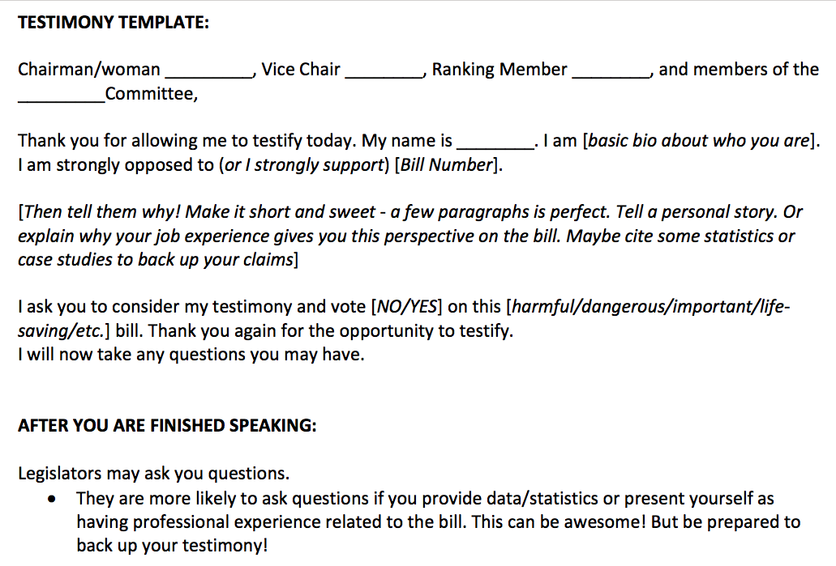

Slide 27
This is stressful. You deserve a few seconds to breathe. Here’s a kitten.
Now, on to the next part of the presentation!

Slide 28
COMMITTEE RULES – PART 1
Texting is ok
Tweeting is ok.
Facebook posts are ok.
It’s fine to have your phone out.
Photos are SOMETIMES ok….
But sometimes the Chair will announce no photos.
You cannot record video or audio without permission.

Slide 29
COMMITTEE RULES – PART 2
We’ve started seeing new rules recently….
Invite-only testimony
Limited number of testimonies accepted.
It will take public pressure to stop these new rules from becoming the norm.
Post all over social media!
Make sure the press knows!
Protest in the halls of the Statehouse.
Eventually, committee chairs will realize it’s much easier to just let everyone testify.

Slide 30
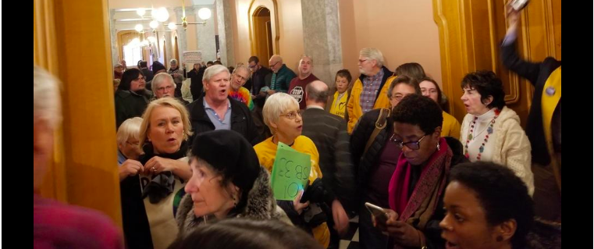

Slide 31
LIVE BROADCASTS OF COMMITTEE HEARINGS
You can watch all House and Senate Sessions AND all committee hearings live on OhioChannel.org – it’s free!
The videos are also archived on the site!
This is a massive win for Statehouse Democrats.

Slide 32
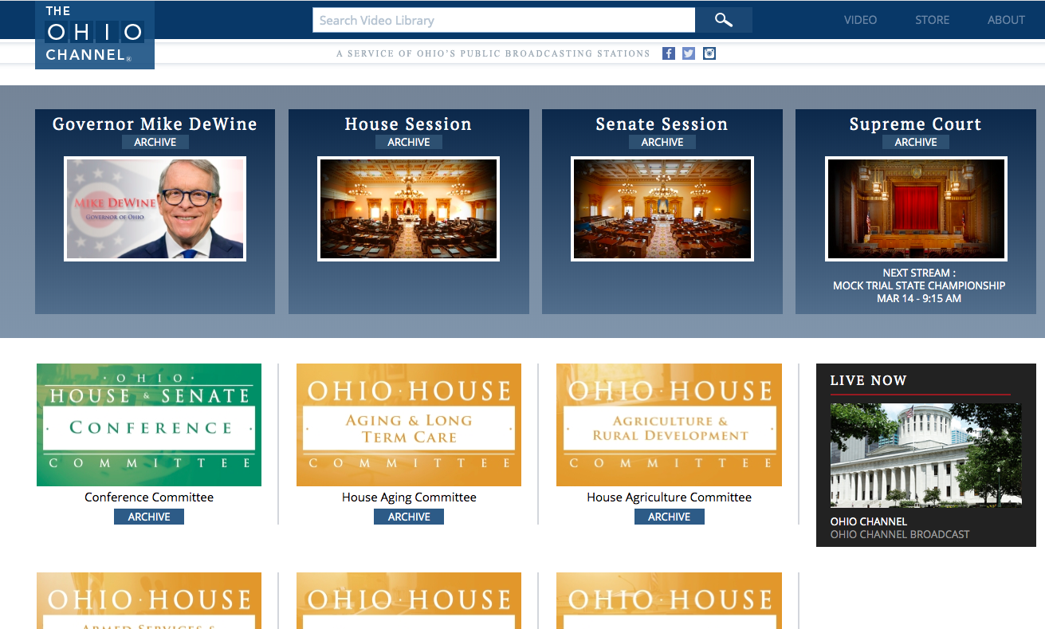

Slide 33
SO A BILL PASSES OUT OF COMMITTEE….
Once a bill passes out of committee, it next needs to receive a full floor vote.
Some bills get through committee but never get to the floor.

Slide 34
SO A BILL GETS A FLOOR VOTE….
If it passes one chamber (the House or the Senate), it then has to go through the full process in the other chamber.

Slide 35
This is stressful. You deserve a few seconds to breathe. Here’s a puppy.
Now, on to the next part of the presentation!

Slide 36
WHAT ELSE CAN YOU DO? STAY INVOLVED – ALL THE TIME!
Suggest new bills!
Lots of our bill ideas come from citizens.
You do not need to know how to write a bill.
Just find a legislator who is interested and they will have the bill drafted for you.
Schedule Lobby Days for your group.
Share articles on social media and give people a task to do.

Slide 37
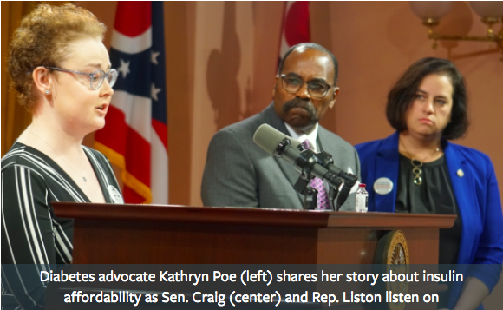

Slide 38
RESOURCES - OHIOHOUSE.GOV AND OHIOSENATE.GOV

Slide 39
RESOURCES - OHIOHOUSE.GOV AND OHIOSENATE.GOV

Slide 40
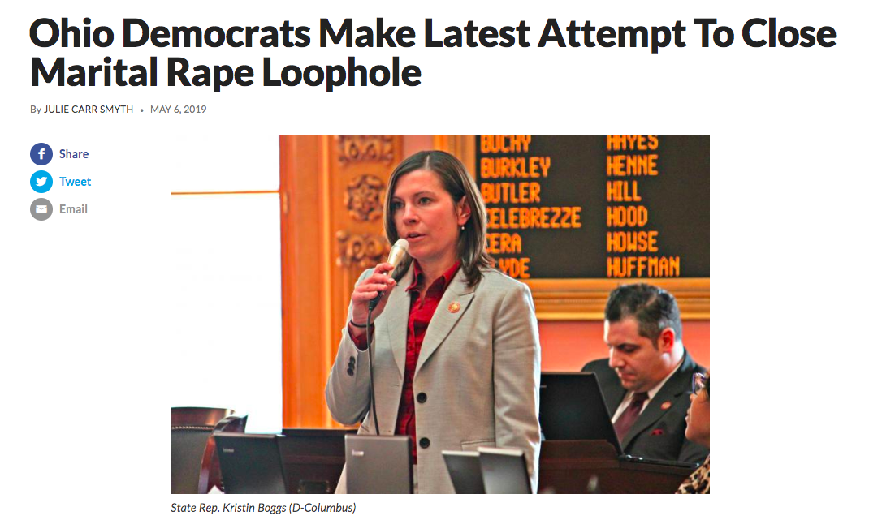

Slide 42
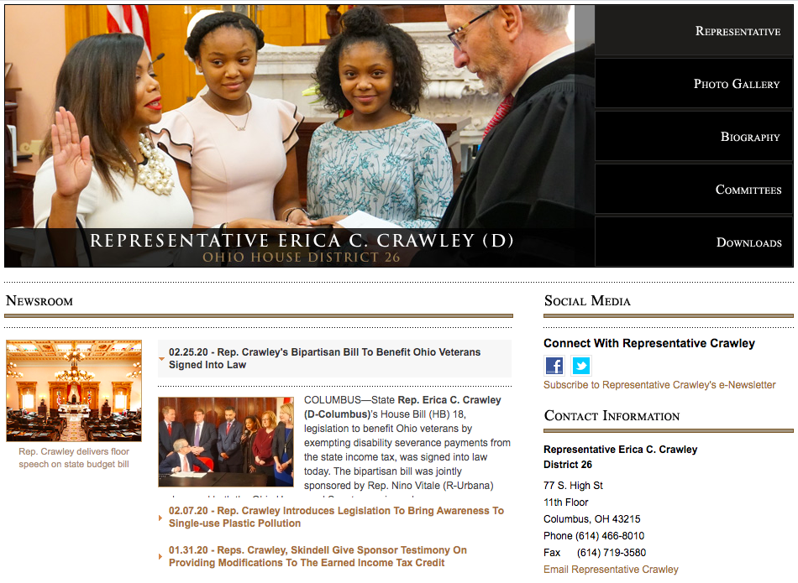
RESOURCES - OHIOHOUSE.GOV AND OHIOSENATE.GOV

Slide 43
RESOURCES – ADVOCACY ORGANIZATIONS

Slide 44
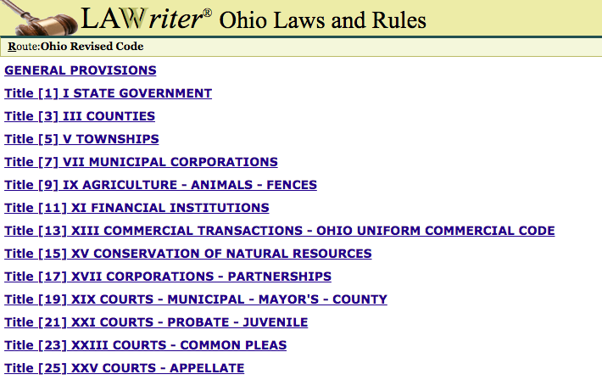
RESOURCES - CODES.OHIO.GOV

Slide 45
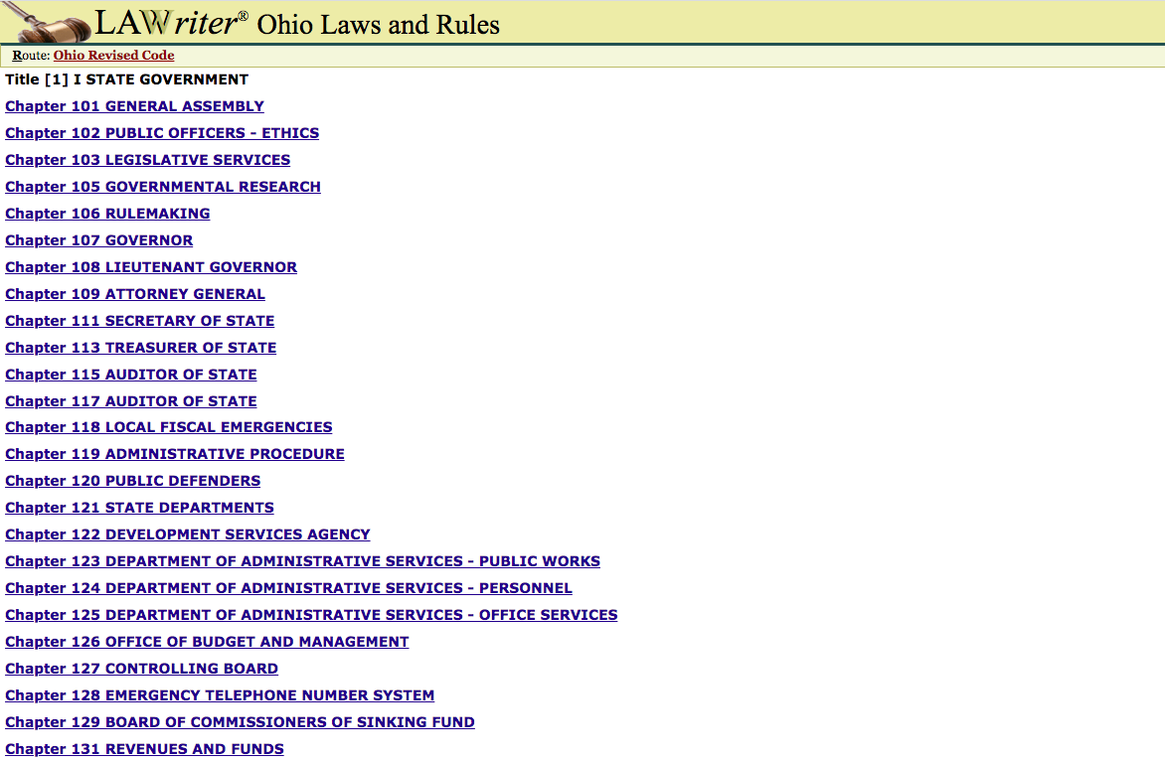

Slide 46
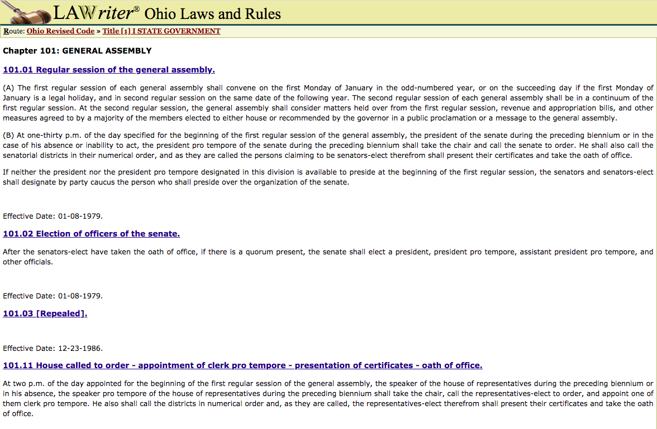

Slide 47
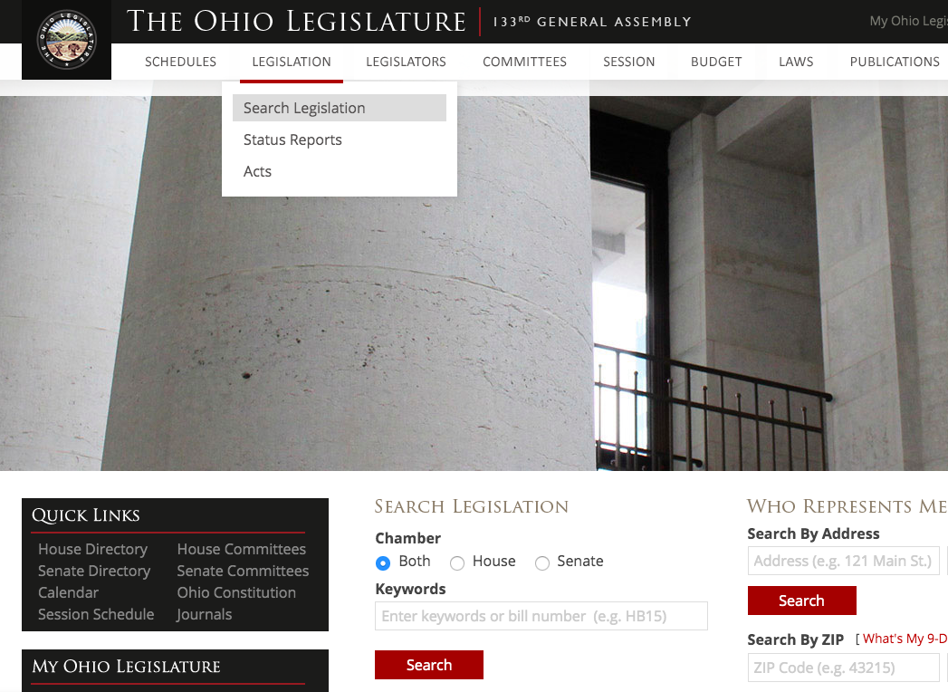
HOW TO FIND STATEHOUSE BILLS

Slide 48
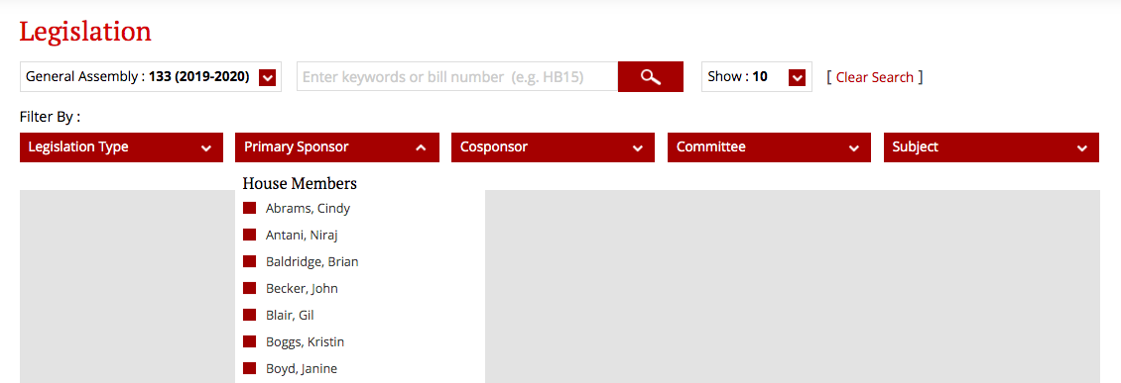
HOW TO FIND STATEHOUSE BILLS

Slide 49
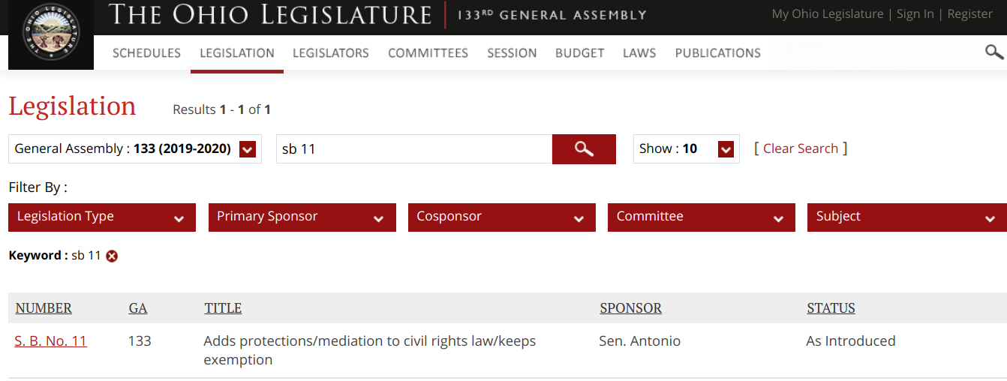

Slide 50
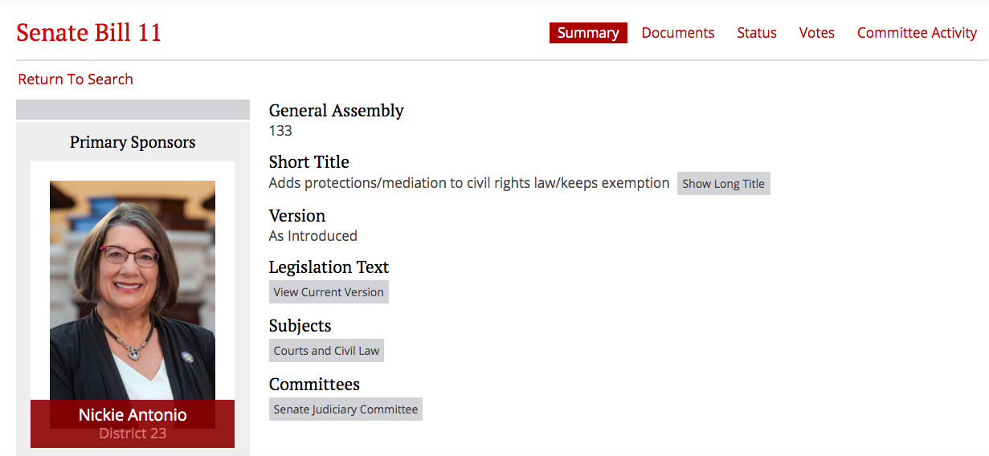
BILL PAGES LOOK LIKE….

Slide 51
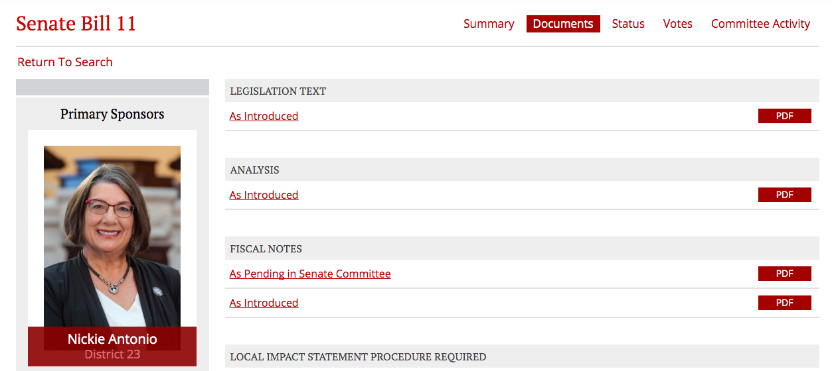
The Documents Tab is so important!

Slide 52
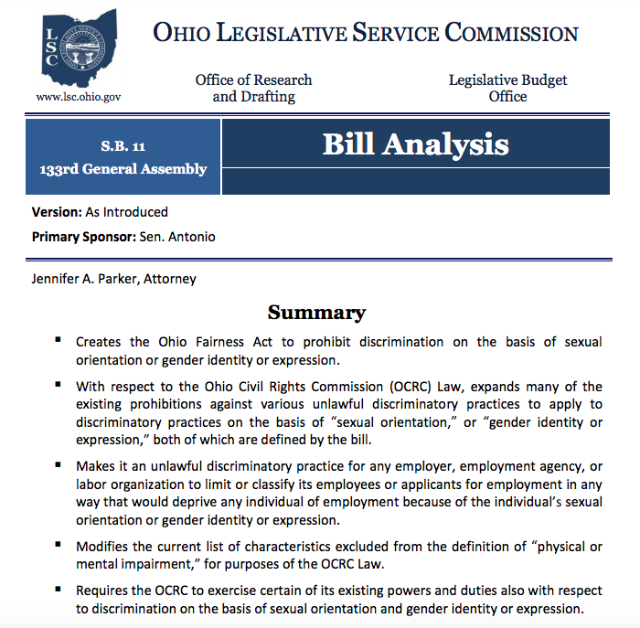

Slide 53
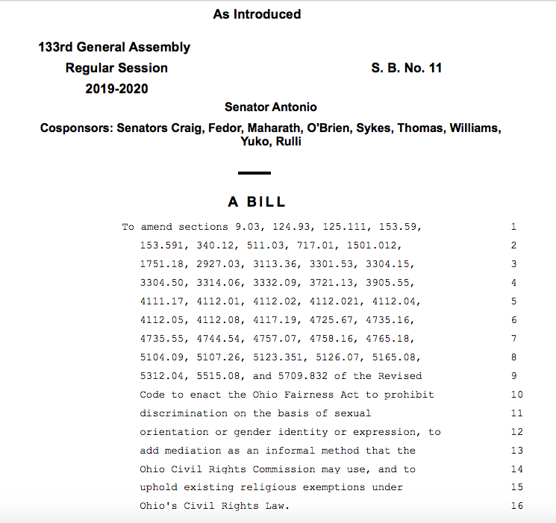

Slide 54
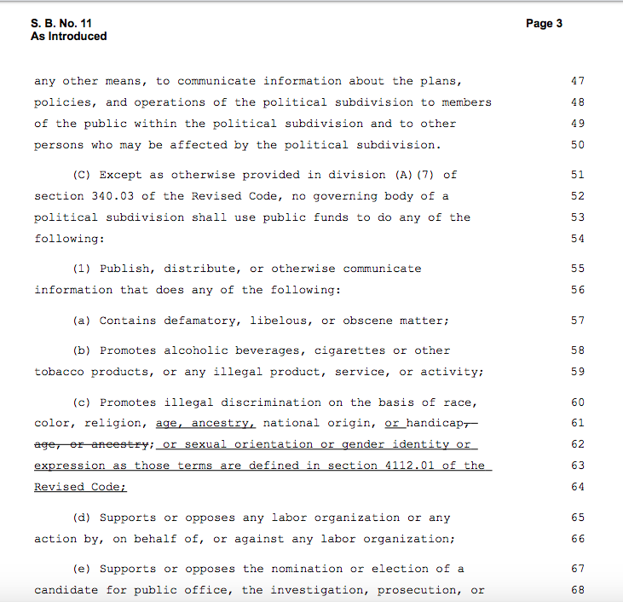

Slide 57
THINGS TO REMEMBER:
Anything you do at the Statehouse level is more than was happening before!
YOU HAVE SO MUCH POWER at the Statehouse level.

Slide 58
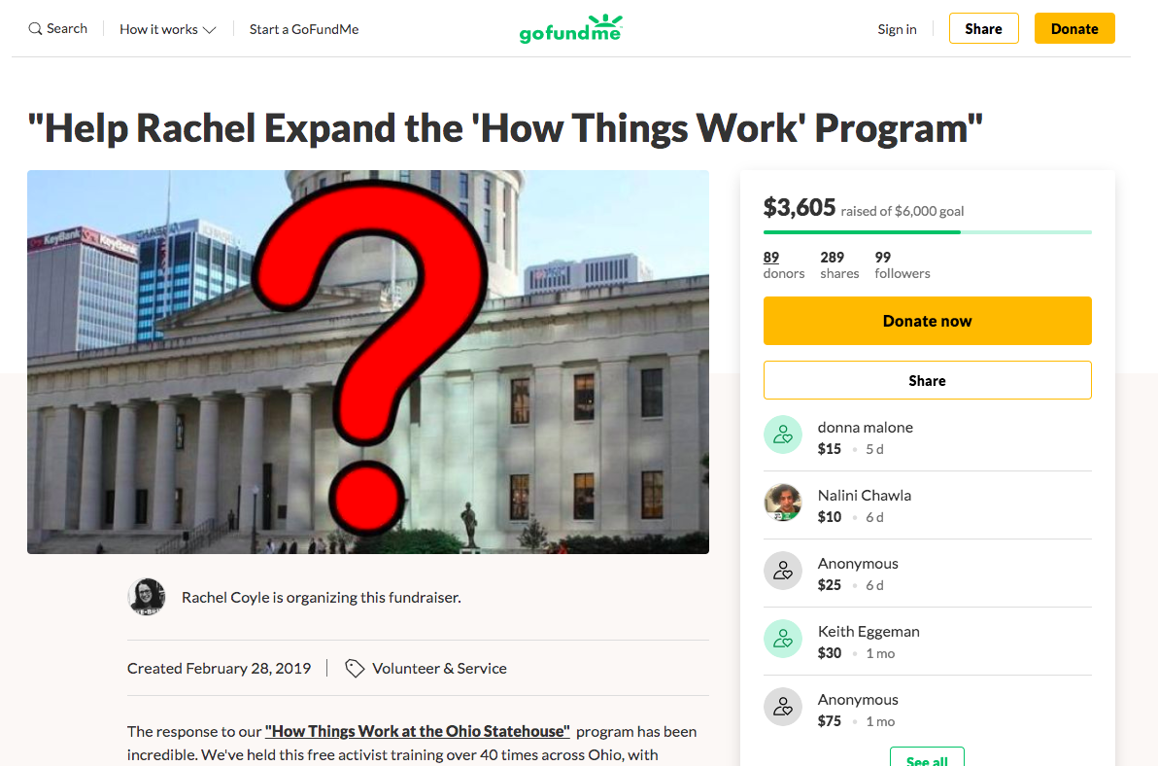
Website: GoFundMe.com

Slide 59
QUESTIONS?

